Slide 1
VERSION CONTROL SYSTEM

Slide 2
WHAT IS VCS ??
Version control systems are a category of software tools that help a software team manage changes to source code over time. Version control software keeps track of every modification to the code in a special kind of database.
RADHIKA DUA

Slide 3
PROS of VCS
People from different part of the world can contribute to the project easily.
If we screwed up our project we can go back in time and use that version of our project.

Slide 4

DISTRIBUTED VERSION CONTROL SYSTEM

Slide 5
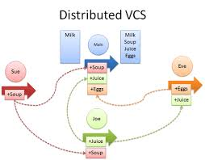
EXAMPLE OF DISTRIBUTED VCS

Slide 6
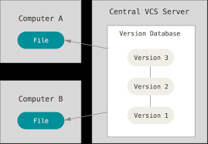
CENTRALIZED VERSION CONTROL SYSTEM

Slide 7
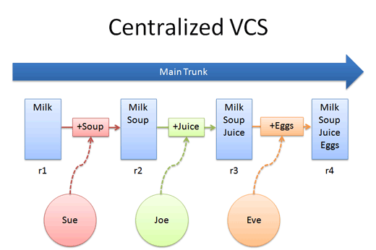
EXAMPLE OF CENTRALIZED VCS

Slide 8
INSTALLING GIT
For windows:
Download git http://bit.ly/git_vcs, run the setup and do the next next finish.
For Linux:
sudo apt-get install git

Slide 9
Making an account on git
git config --global user.name “Your name”
git config --global user.email “Your email”

Slide 10
Git and Github/bitbucket
Git is a revision control system, a tool to manage your source code history.
GitHub is a hosting service for Git repositories.

Slide 11
What is a repository?
A directory or storage space where your projects can live. Sometimes GitHub users shorten this to “repo.” It can be local to a folder on your computer, or it can be a storage space on GitHub or another online host. You can keep code files, text files, image files, you name it, inside a repository.

Slide 12
Create a repository….
Command: Open command prompt/terminal and write the below command to initialize the repository.
git init
Git repository or initialize a new empty repository. Most of the other Git commands are not available outside of an initialized repository, so this is usually the first command you’ll run in a new project.

Slide 13

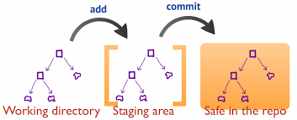
Work flow

Slide 14
3 Commands confusing yet important
Commands:
git add :This command adds your modified files to the queue to be committed later. Files are not committed.
git commit: This command commits the files that have been added and creates a new revision with a log. If you do not add any files, git will not commit anything. You can combine both actions with git commit -a
git push: This command pushes your changes to the remote repository.
To be continued……

Slide 15
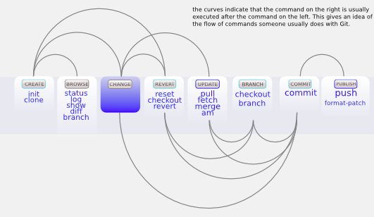
Lastly, the reason why push is a separate command is because of git's philosophy. git is a distributed versioning system, and your local working directory is your repository! All changes you commit are instantly reflected and recorded. push is only used to update the remote repo (which you might share with others) when you're done with whatever it is that you're working on. This is a neat way to work and save changes locally (without network overhead) and update it only when you want to, instead of at every commit. This indirectly results in easier commits/branching etc (why not, right? what does it cost you?) which leads to more save points, without messing with the repository.

Slide 16
Fork and clone ?
Forked project is your online repository (repo).
Cloned project/downloaded is on your local machine.

Slide 17
How to clone a repository from command line?
1.On GitHub, navigate to your fork of the Spoon-Knife repository.
2. Under the repository name, click Clone or download.
3.In the Clone with HTTPs section, click to copy the clone URL for the repository.
4. Open Terminal.
5. Type git clone, and then paste the URL you copied in Step 2. It will look like this, with your GitHub username instead of YOUR-USERNAME and repository name. eg: git clone https://github.com/YOUR-USERNAME/repositoryname
6. Press Enter. Your local clone will be created.
RADHIKA DUA

